Slide 1
Advanced Python
Numpy

Slide 2

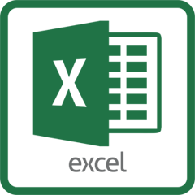
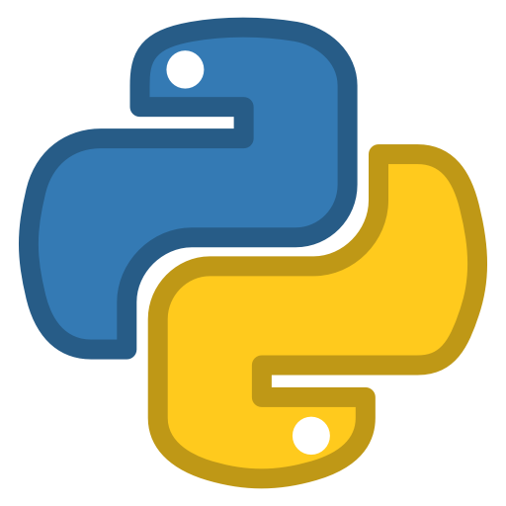




Where we are today
1st Half Semester
2nd Half Semester
Leverage Python for Data Analytics that is traditionally done through Excel (Table/Formula/Pivot/Macro)
Leverage Python for automation of daily task,
data science module, guest speaker
Week 2: Numpy
Week 3: Pandas Part I
Week 4: Pandas Part II
Week 5: Pandas Part III
Week 6: Visualization
Week 7: Text Processing / Data Integration
Week 8: Midterm Project Presentation
Week 9: Spring Break
Week 10: Web Data Gathering
Week 11: Guest Speaker
Week 12: Intro to Scikit-Learn
Week 13: Scikit-Learn Part II
Week 14: Scikit-Learn Part III
Week 15: Final Project Presentation
Midterm Project Instructions will be posted coming week

Slide 3

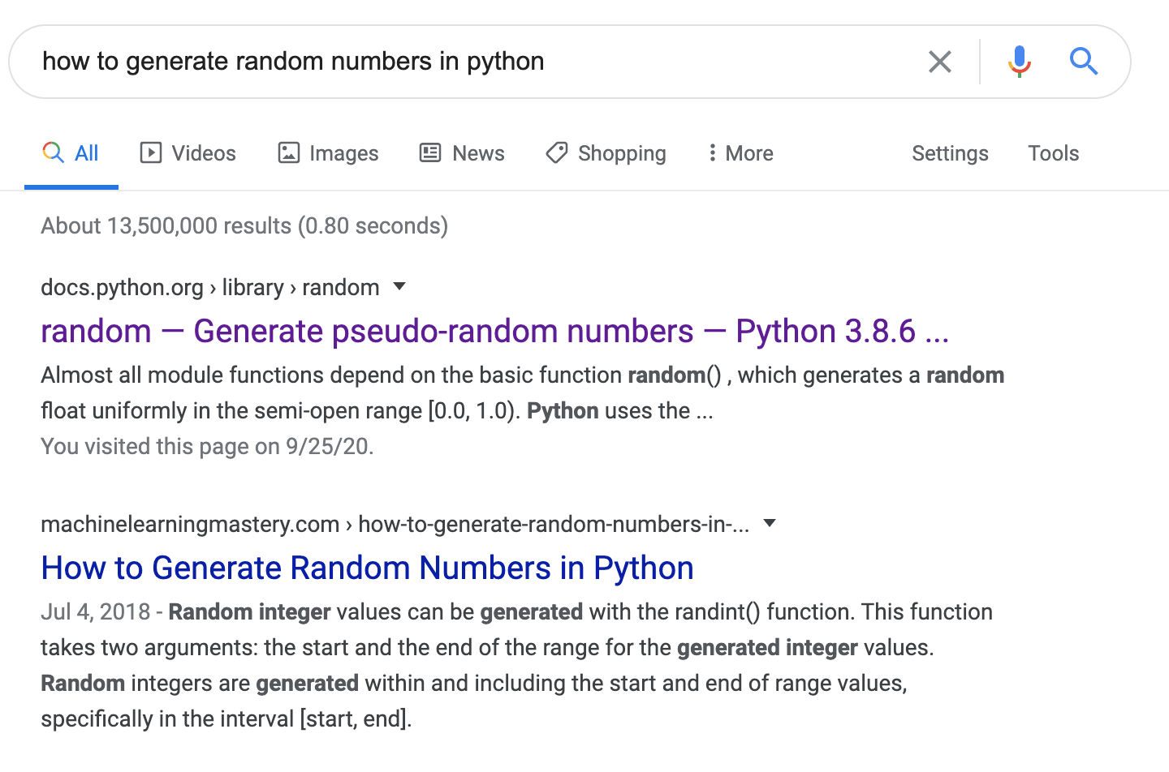


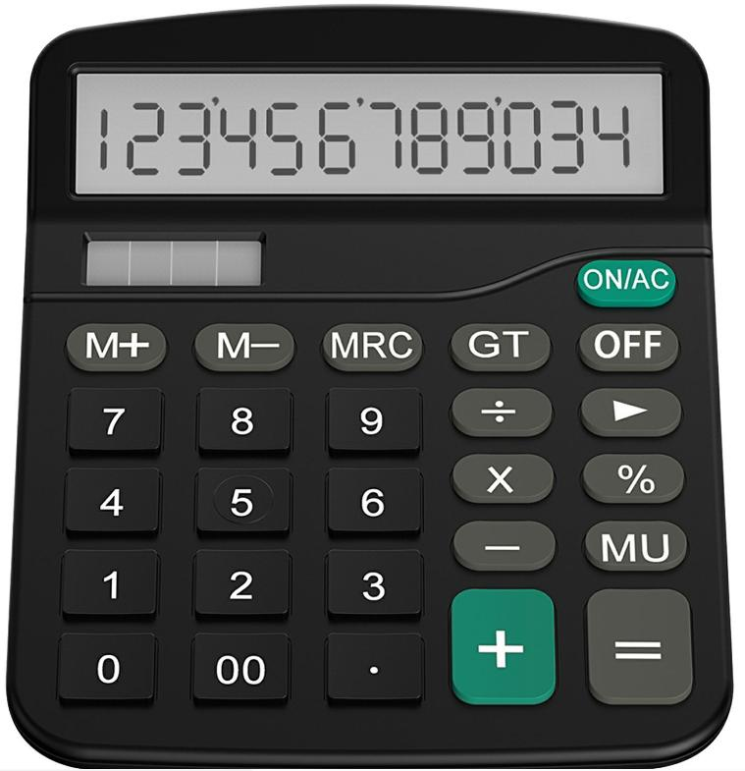
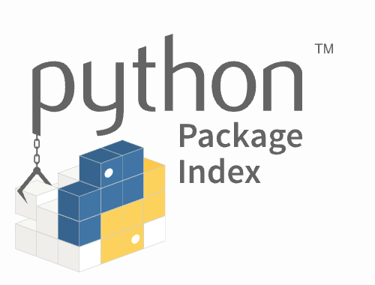
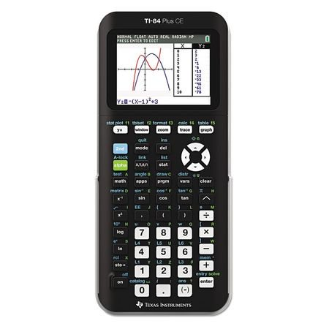
Library
Find the right tool for the right job, so you don’t have to re-create the wheel
Stackoverflow
Google
Pypi.org

Slide 4

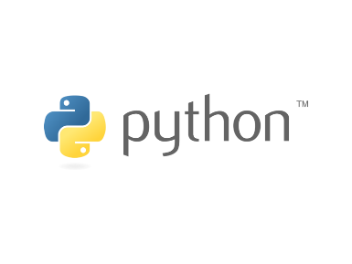
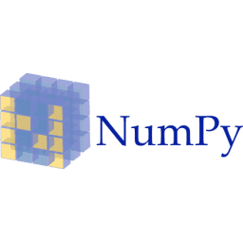
Python Libraries / Packages
Pip Install
Standard Libraries
Over 600 Packages from Anaconda
For most common libraries, there are usually manual/tutorial offered on Internet

Slide 5
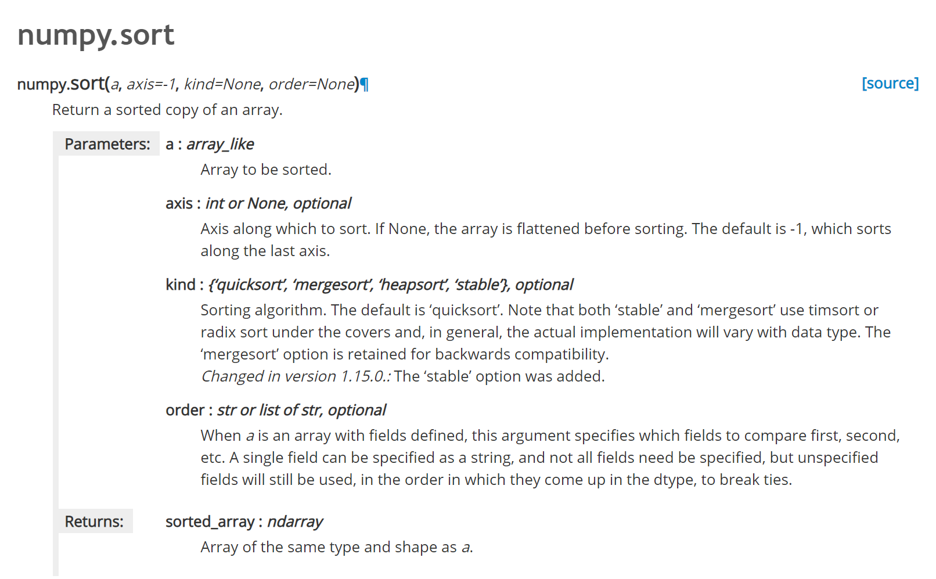
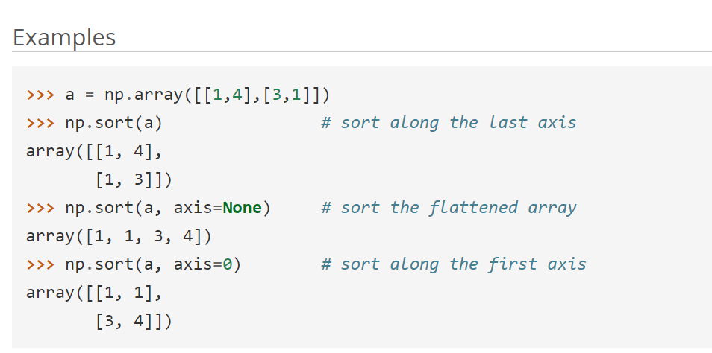
Python Libraries / Packages
NumPy Manual
https://docs.scipy.org/doc/numpy/reference/
Function Input Variables
Examples on how to use the function
Function Name
Input Variable Description
https://docs.scipy.org/doc/numpy/reference/generated/numpy.sort.html

Slide 6
Py Data Ecosystem
NumPy: Underlying abstraction that sits below basically all of the libraries
Contains an efficient n-dimensional array representation
Pandas: Excellent data manipulation framework that is more user-friendly interface for NumPy and SciPy
MatPlotLib: Plotting and graphics library
Good integration with pandas
SciPy: Scientific computing framework that sits on top of NumPy
Scikit-Learn/Scikit-Image: Machine learning library

Slide 7
Introduction to NumPy
NumPy: NumPy is the fundamental package for scientific computing in Python. It is a Python library that provides a multidimensional array object, various derived objects (such as masked arrays and matrices), and an assortment of routines for fast operations on arrays, including mathematical, logical, shape manipulation, sorting, selecting, I/O, discrete Fourier transforms, basic linear algebra, basic statistical operations, random simulation and much more.
NumPy offers many Array Functions, Statistic Functions, and many more
Key: Numpy Runs Data Fast

Slide 8
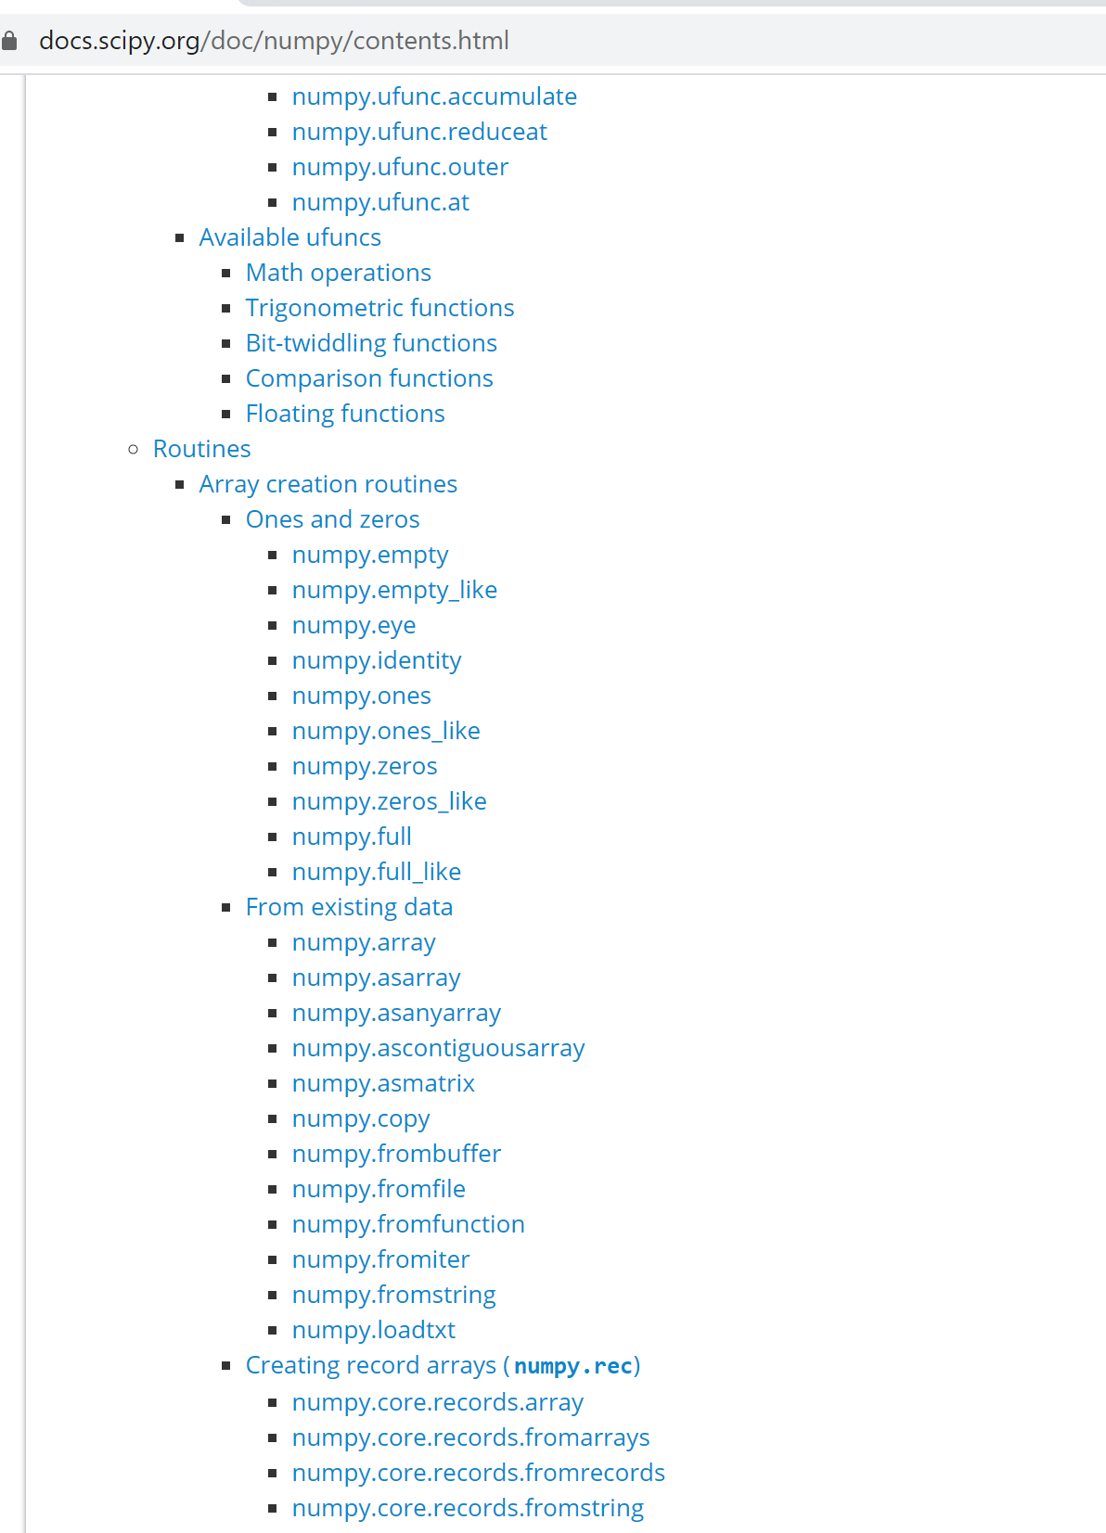
When Not Sure, always go back to documentation
https://docs.scipy.org/doc/numpy/contents.html
Routine section of Numpy documentation website demonstrates many of the NumPy functions and how to use them

Slide 9
NumPy Features
NumPy Data Structure
Setup
Min/Max
Properties of Array
Vector
Setup
Vector computing
Query/Slicing/Combining Array
Vector Manipulation
Concatenate
Slice
Stack
Sort
Note: All demo sample codes will be posted on Canvas after lecture

Slide 10
NumPy Exercise

Slide 11
NumPy Application
Can NumPy help me with my statistics Homework?

Slide 12

Probability Problem #1
Assuming a deck with 52 cards, no jokers, if we randomly select three cards from the deck, what is the probably that all of them are same suit?

Slide 13
Probability Problem #1
Assuming a deck with 52 cards, no jokers, if we randomly select three cards from the deck, what is the probably that all of them are same suit?
13/52 * 12/51 * 11/50 * 4

